Slide 1
PROGRAM EXAMPLE and CONCEPTS
Motor with Indicators
© 2021 John Sefcovic.

Slide 2
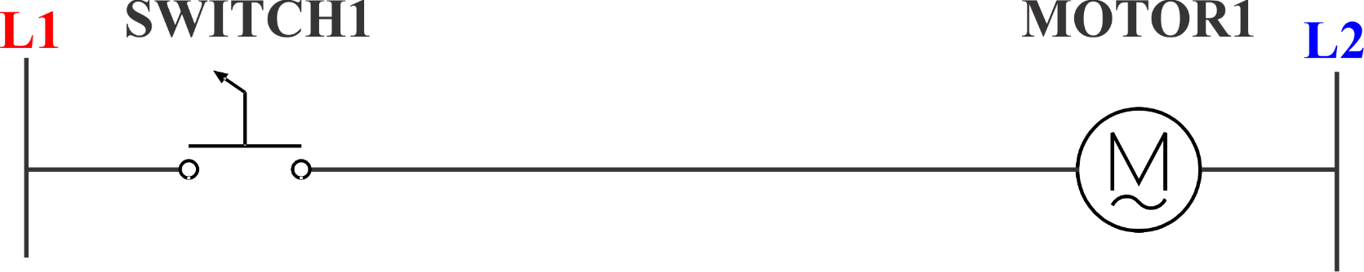
Motor Switch
To control a simple MOTOR, the output device would be wired directly to the controlling input.
By turning the SWITCH and making its contacts, the fan motor would turn on.

Slide 3
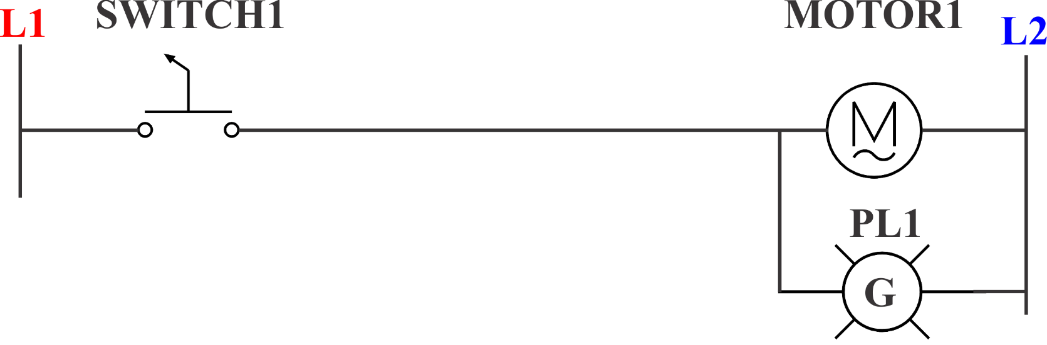
Simple Switch with ON indicator
If a PILOT LIGHT is added, it would also be wired to the switch.

Slide 4
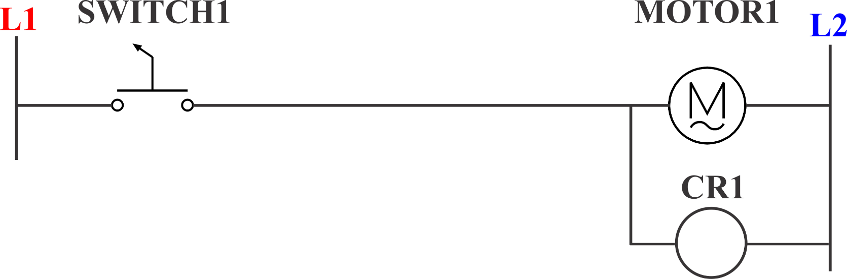
Simple Switch with ON/OFF Indicator
If a red pilot light was added to indicate that the motor was off, an INTERNAL CONTROL RELAY would have to be wired into the circuit.
The electrical contacts of the INTERNAL CONTROL RELAY would then be wired to the green and red pilot lights.

Slide 5
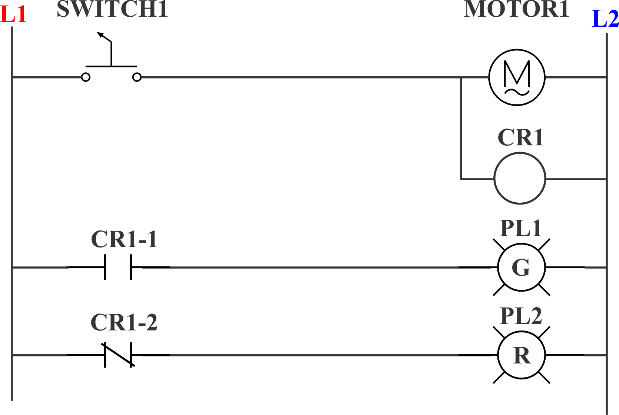
Simple Switch with ON/OFF Indicator
By wiring the pilot lights to different types of contacts on CR1, NORMALLY OPEN and NORMALLY CLOSED, the pilot lights are turned on appropriately.

Slide 6
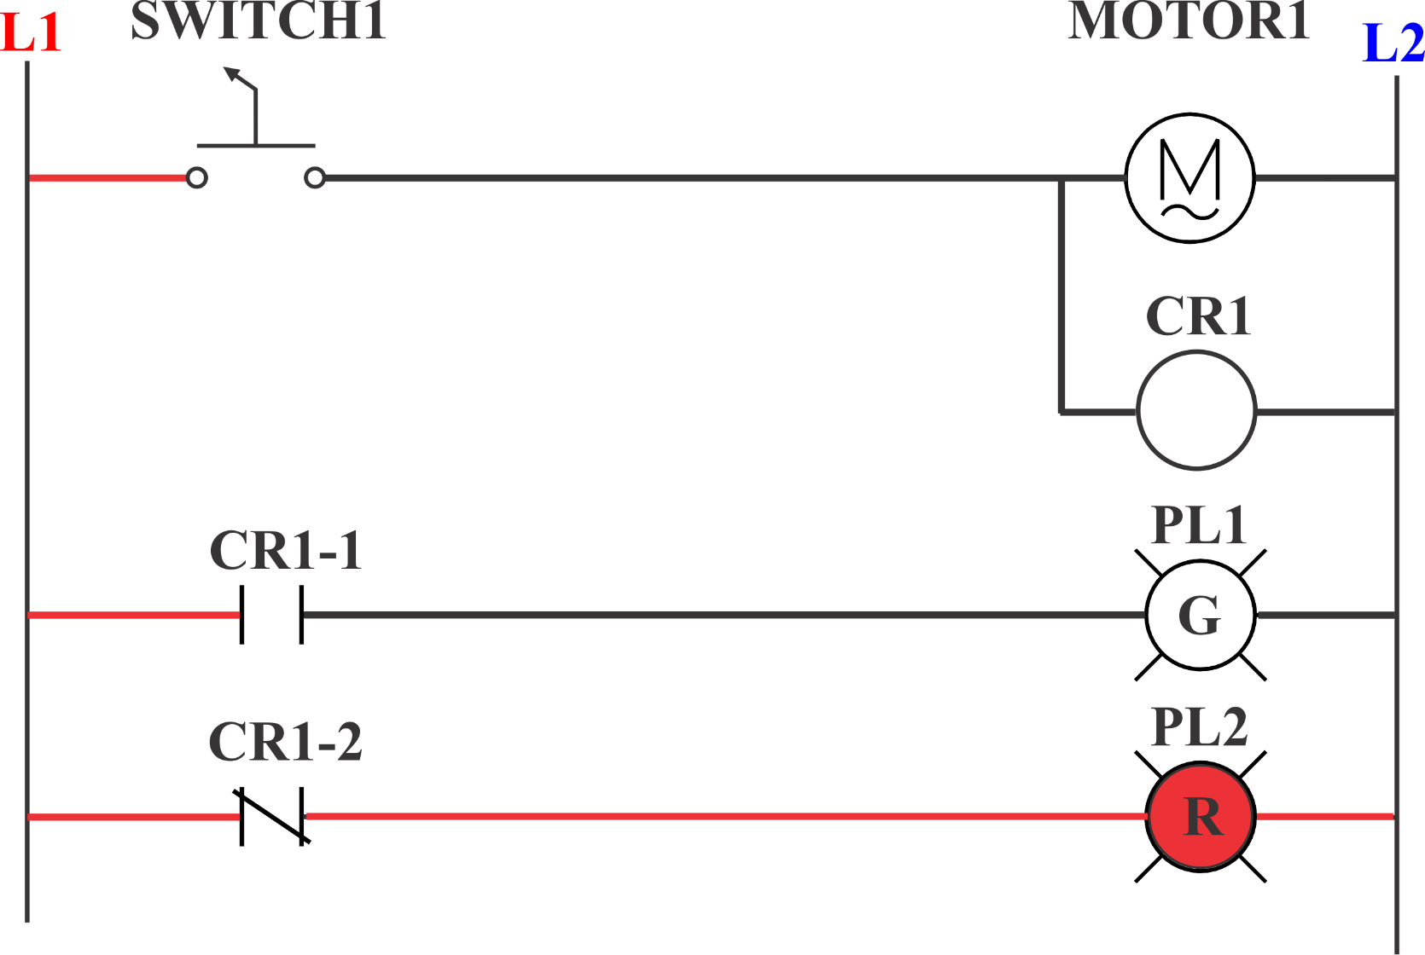
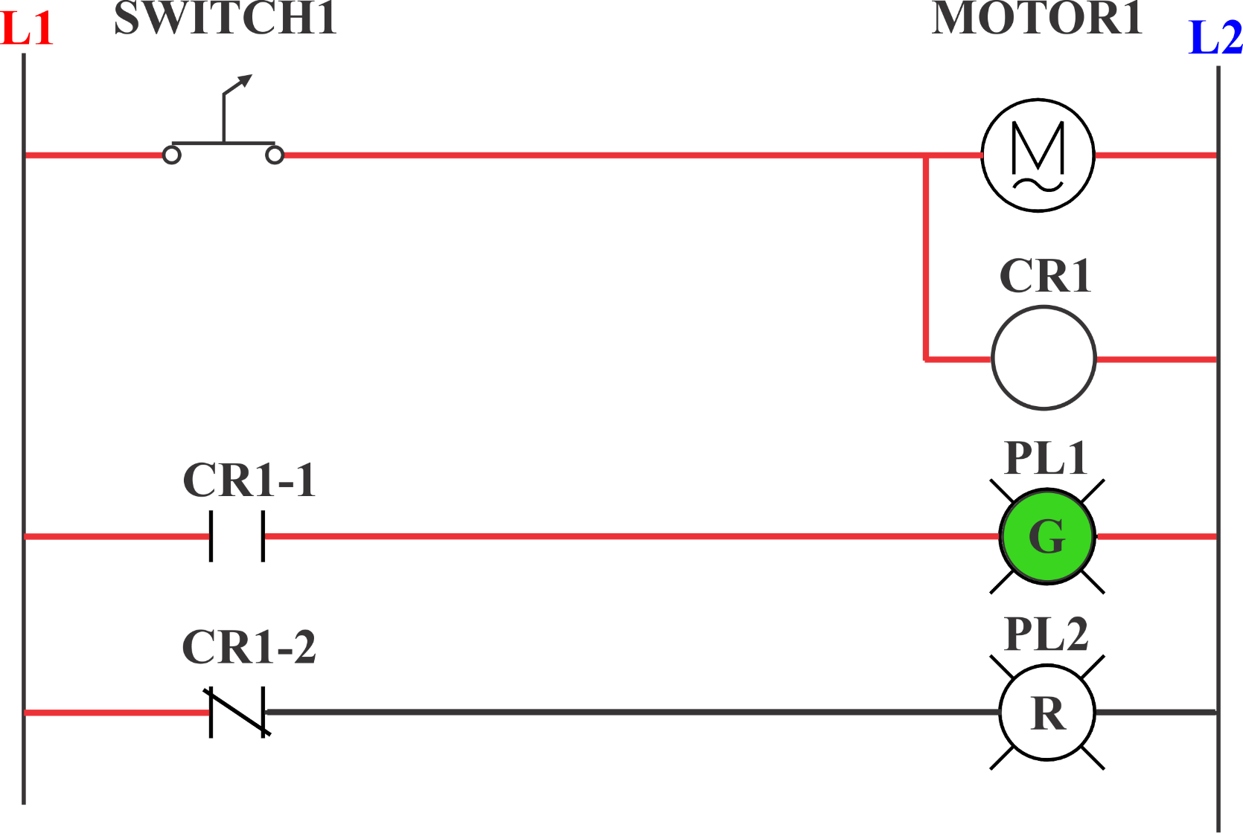
Simple Switch with ON/OFF Indicator
When the switch closes, the ELECTRICAL CONTINUITY of the circuit changes.

Slide 7
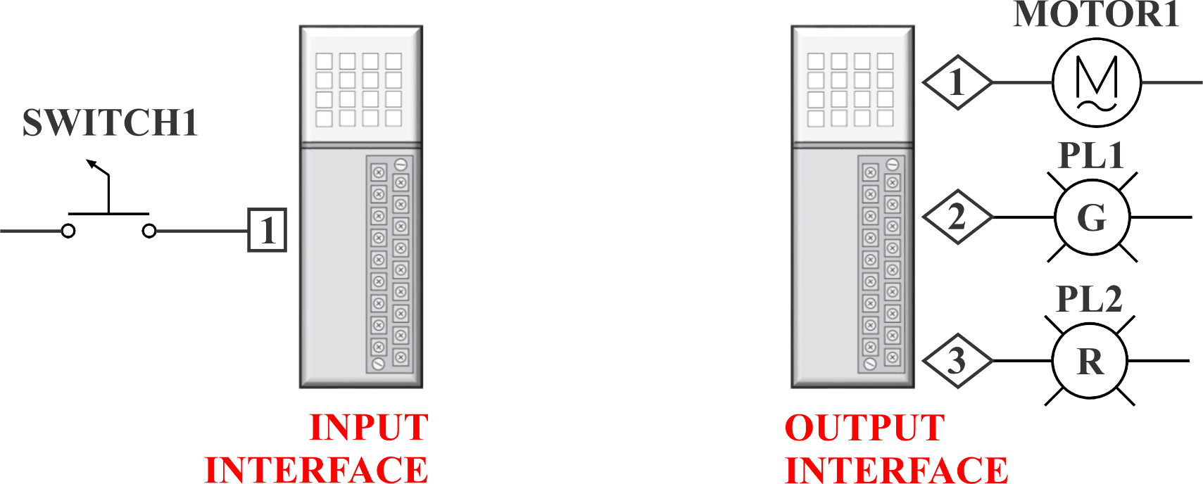
PLC Connections with ON/OFF Indicator
For a PLC, the field devices are wired to INPUT/OUTPUT INTERFACE MODULES, they are NOT PHYSICALLY CONNECTED together.

Slide 8
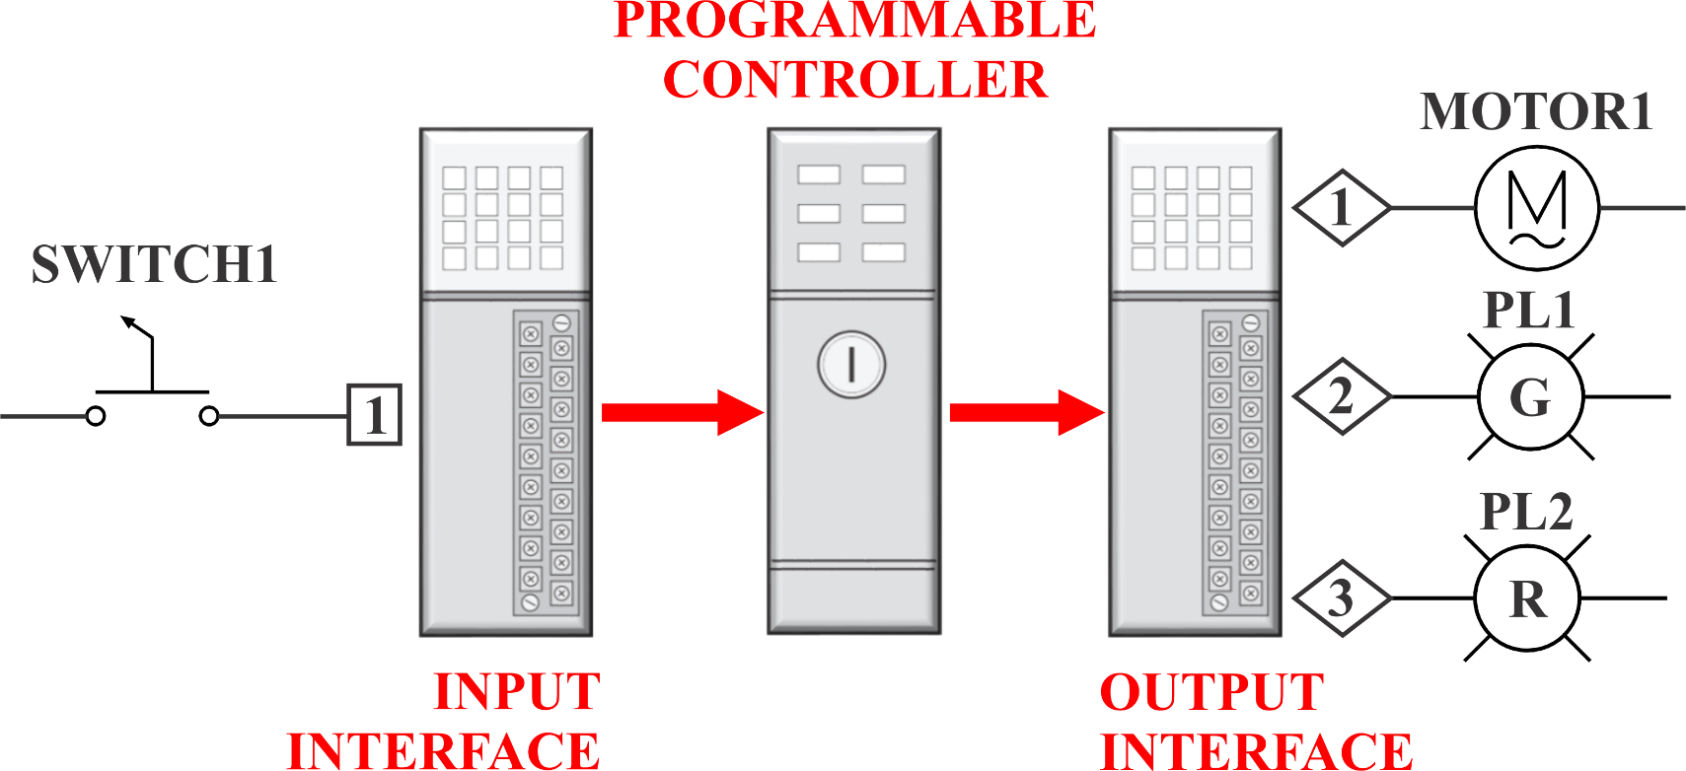
PLC Connections with ON/OFF Indicator
The state of the Input contacts provides information to the PLC’s processor ...
… and is used by the PLC processor’s Logic
Program to control the Outputs.

Slide 9
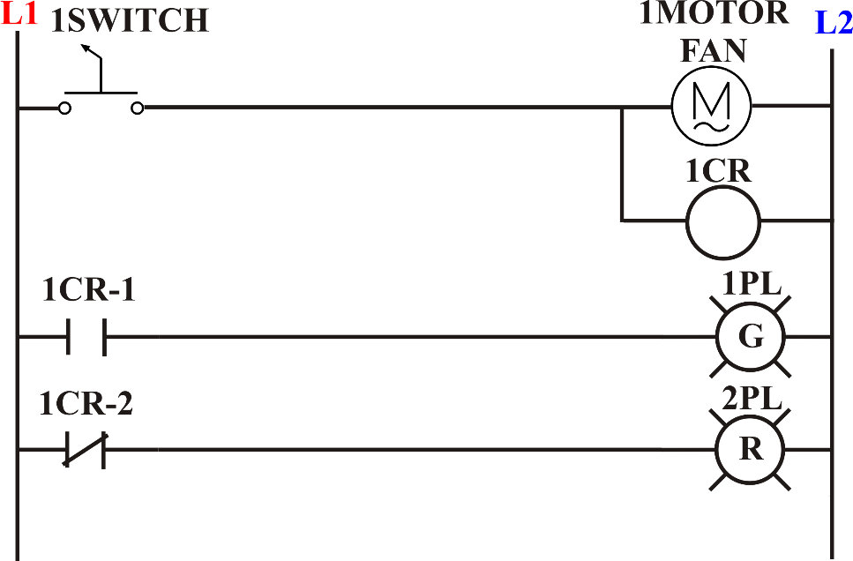
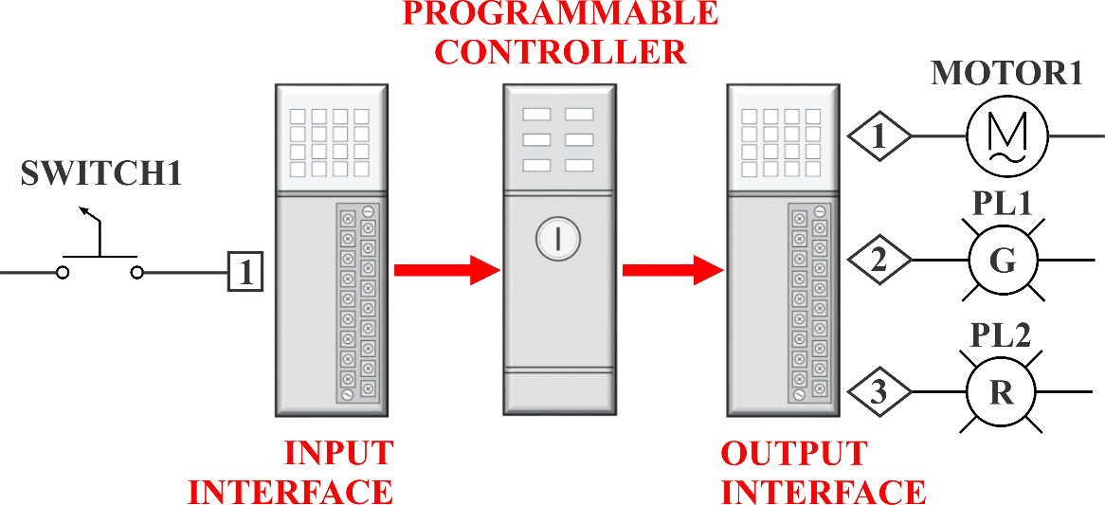
Electrical and Logic Continuity
The Programmable Controller uses the electrical signals at the INPUT INTERFACE converted to Data Information for a LOGIC CONTINUITY path of TRUE Input Instructions to energize the output devices at the OUTPUT INTERFACE.
An ELECTRICAL CIRCUIT uses contact terminals to complete an ELECTRICAL CONTINUITY path between the L1 and L2 to energize the output devices.
CONTINUITY: an uninterrupted connection.

Slide 10
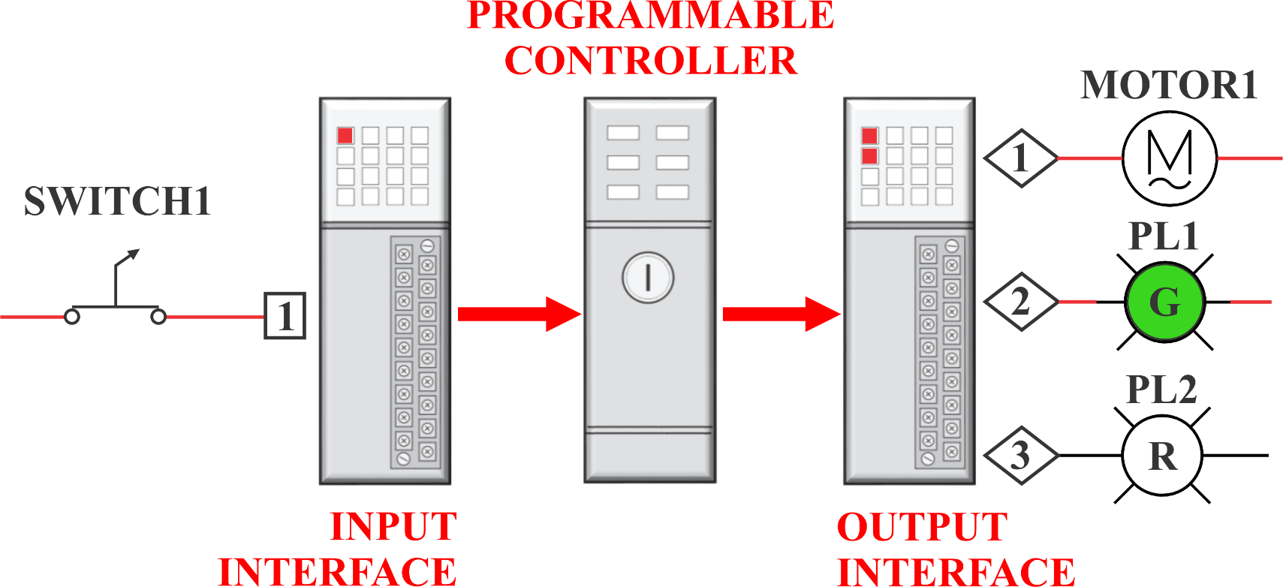
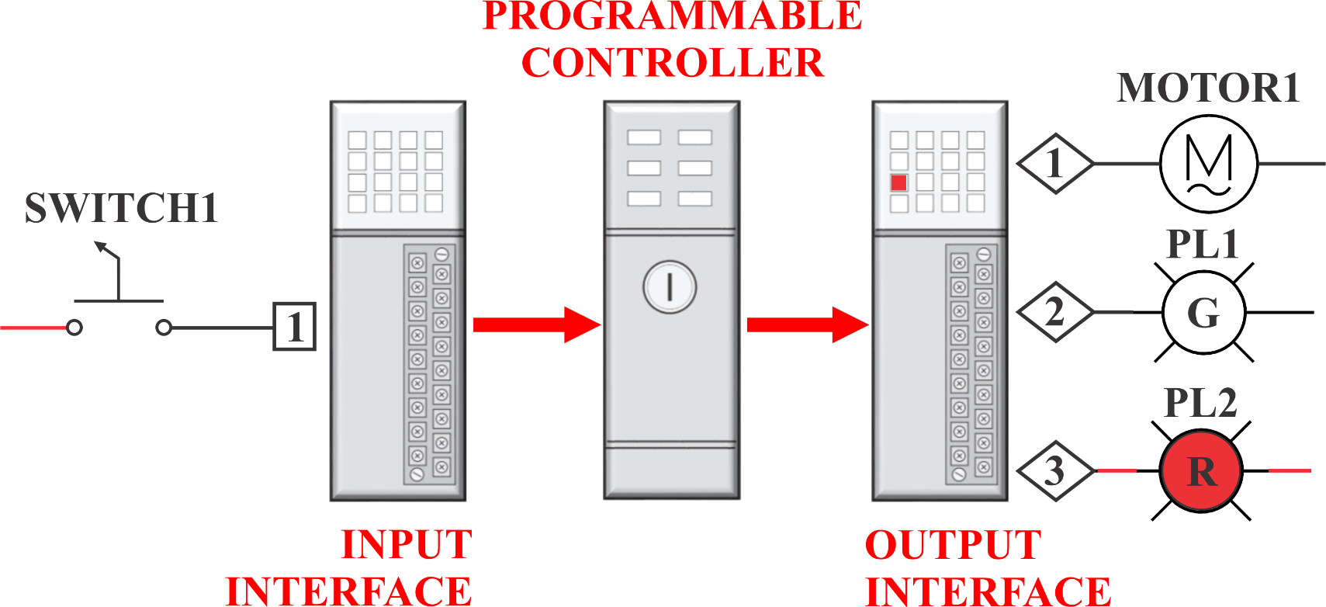
PLC Logic Continuity
When the switch closes, the electrical change at the INPUT will be READ and converted to DATA INFORMATION to be used by the PLC program’s instructions to WRITE the changes to of the OUTPUT devices.

Slide 11
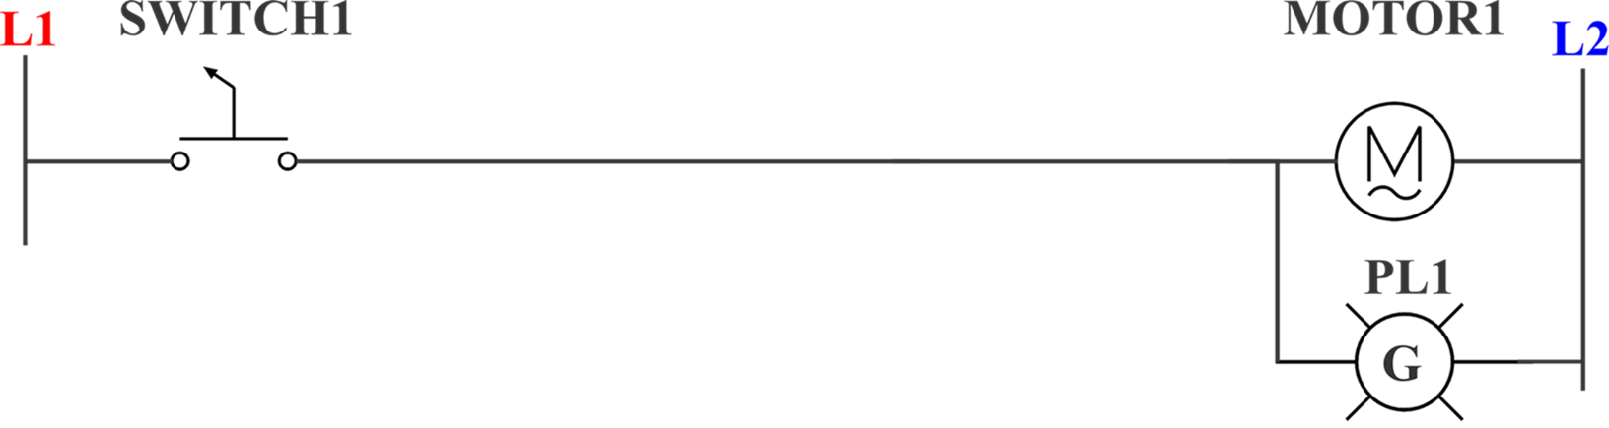
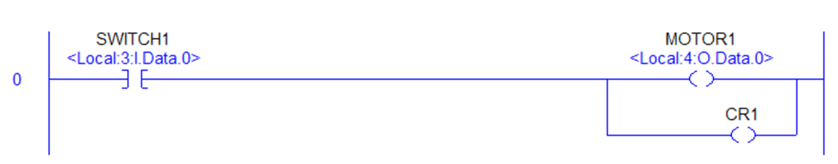
PLC Logic Continuity
The Electrical Circuit and PLC Logic Circuit both use Symbols to represent the devices and Identifier text for the devices.
Both use the concept of Inputs Left to Right Continuity to control the Outputs.
Electrical Circuit
PLC Logic Circuit

Slide 12
Relay Instructions
PROGRAM INPUT INSTRUCTIONS
-] [-
this instruction is TRUE with VOLTAGE.
-] / [-
this instruction is TRUE with NO VOLTAGE.
PROGRAM OUTPUT INSTRUCTION
-( )-
when there is complete continuity path of TRUE Input Instructions the Output is TRUE, VOLTAGE.

Slide 13
Relay Instruction Names
RSLogix 5000
PROGRAM INPUT INSTRUCTIONS
-] [- EXAMINE INPUT CLOSED
-] / [- EXAMINE INPUT OPENED
PROGRAM OUTPUT INSTRUCTIONS
-( )- ENERGIZE OUTPUT
Siemens S7
PROGRAM INPUT INSTRUCTIONS
-] [- NORMALLY OPEN CONTACT
-] / [- NORMALLY CLOSED CONTACT
PROGRAM OUTPUT INSTRUCTIONS
-( )- ASSIGNMENT

Slide 14
Relay Instructions
In the PLC program a Left to Right Continuity path of TRUE Inputs is required to turn On the Outputs
Equivalent Terms
When the Input instruction is TRUE:
-] [- = VOLTAGE = ON = LOGIC '1' = SET
-] \ [- = NO VOLTAGE = OFF = LOGIC '0' = RESET
When the Output instruction is TRUE:
-( )- = VOLTAGE = ON = LOGIC '1' = SET

Slide 15
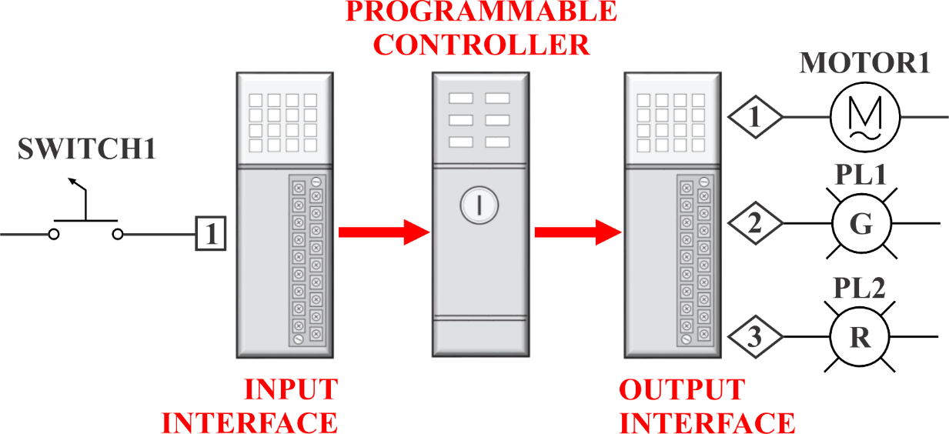
Relay Instructions
A PLC system has Electrical devices (Field Devices) wired to its Input/Output Interfaces that uses Electronics to communicate Data between the Interfaces and PLC processor.
The Electrical state of the Field Devices are represented as Data in the PLC as Logic “1” for ON and Logic “0” for Off.

Slide 16
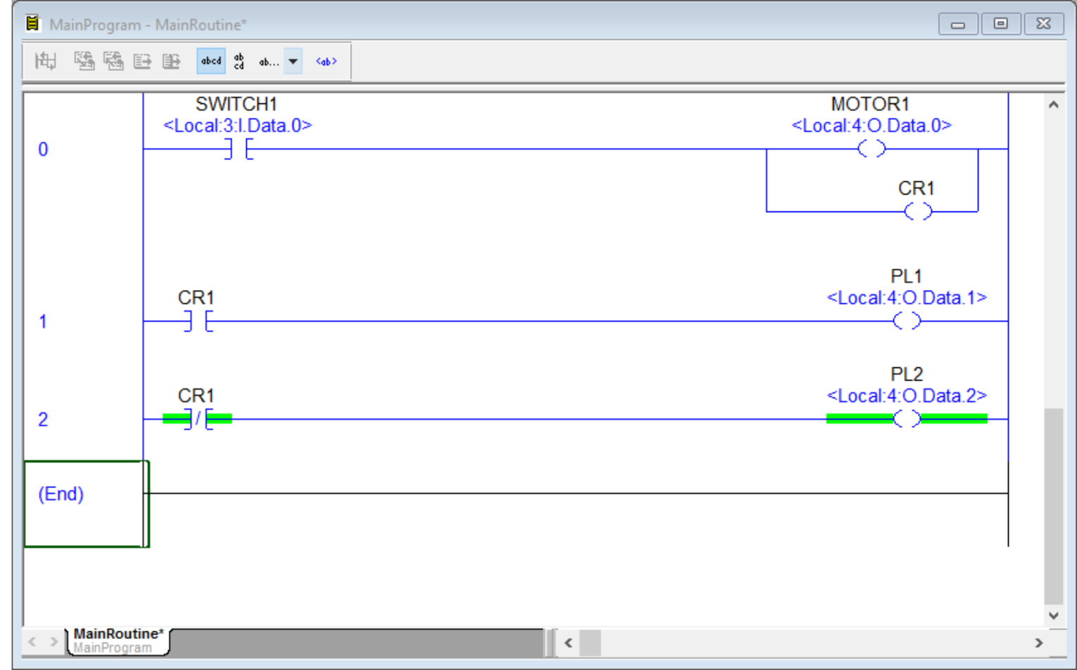
Program Example Studio 5000
Program in Studio 5000

Slide 17
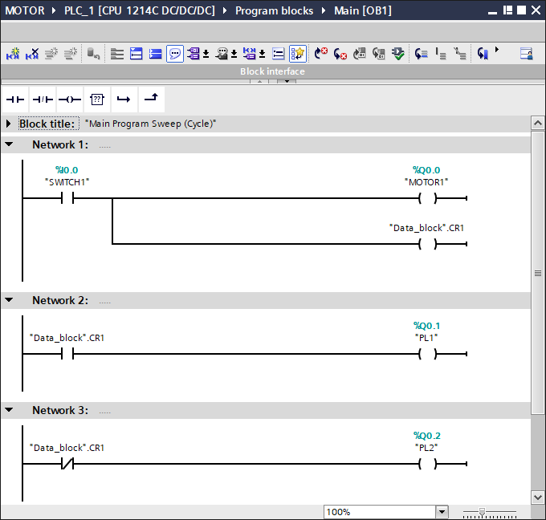
Program Example Siemens
Program in Siemens

Slide 18

Program Example Comparison
Both programs use the Logic Instructions:
-] [-
-] / [-
-( )-
Both programs use the Tags SWITCH1, MOTOR1, CR1, PL1, and PLC2.

Slide 19
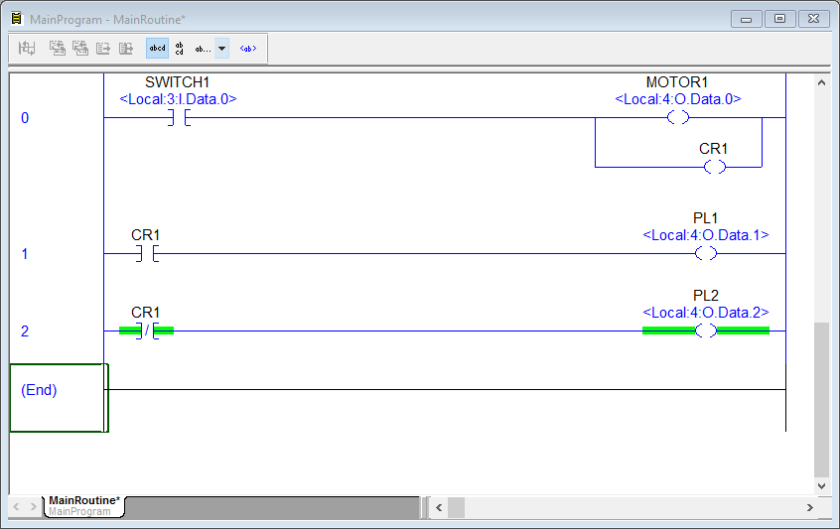
Program Example Comparison
There is a difference in Appearance.
The Address format of the “field device” wired to the Input and Output modules are different.
In Studio 5000 the term for a circuit is a Rung and Siemens uses the term Network.

Slide 20
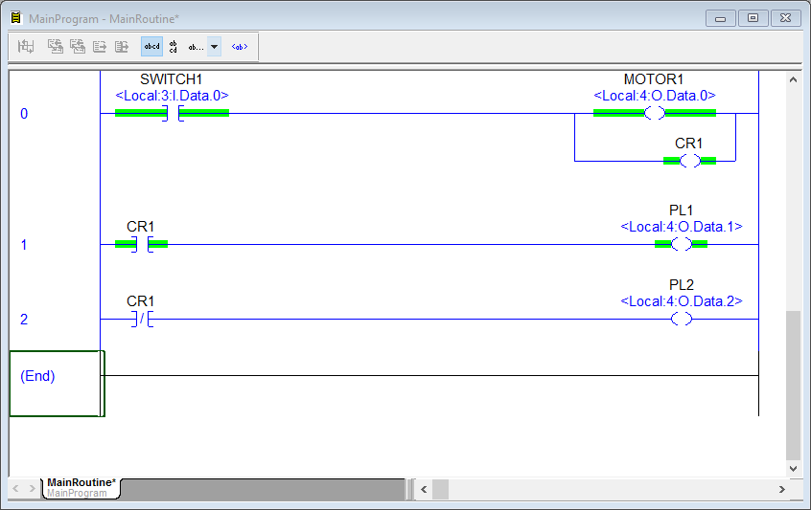

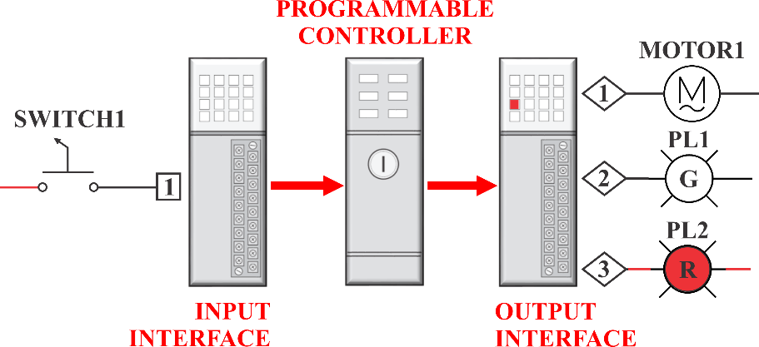
Program Example Logic Continuity
The PLC will use the DATA INFORMATION and the LOGIC PROGRAM to “CONNECT” the inputs to the outputs to create LOGIC CONTINUITY.
The change in INPUT DATA changes the OUTPUT DATA.

Slide 21
Program Example Logic Continuity
True when, -] [- = VOLTAGE = ON = LOGIC '1' = SET
Notice when CR1 is True or On or Logic “1”…
…the Input that shares the same Data CR1 is True.
Notice Output PL1 is True or On because the Input Logic Instruction is True “making Continuity of True Input Instructions.”

Slide 22
Program Example Logic Continuity
True when, -] / [- = NO VOLTAGE = OFF = LOGIC '0' = RESET
Notice when CR1 is False or Off or Logic “0”…
…the Input that shares the same Data CR1 is True.
Notice Output PL2 is True or On because the Input Logic Instruction is True “making Continuity of True Input Instructions.”

Slide 23
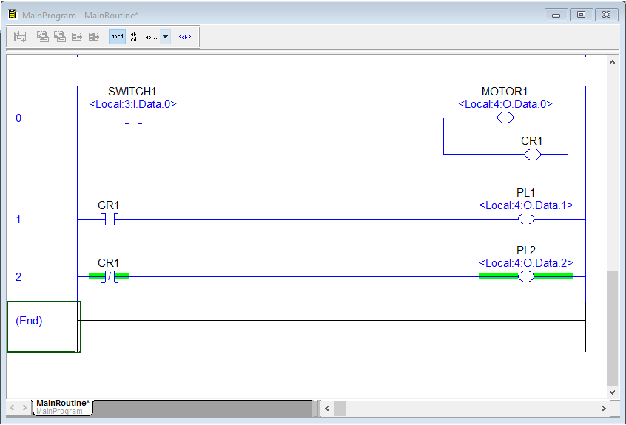
Program Example
Notice in this example, the ladder logic and hardwired are similar.

Slide 24
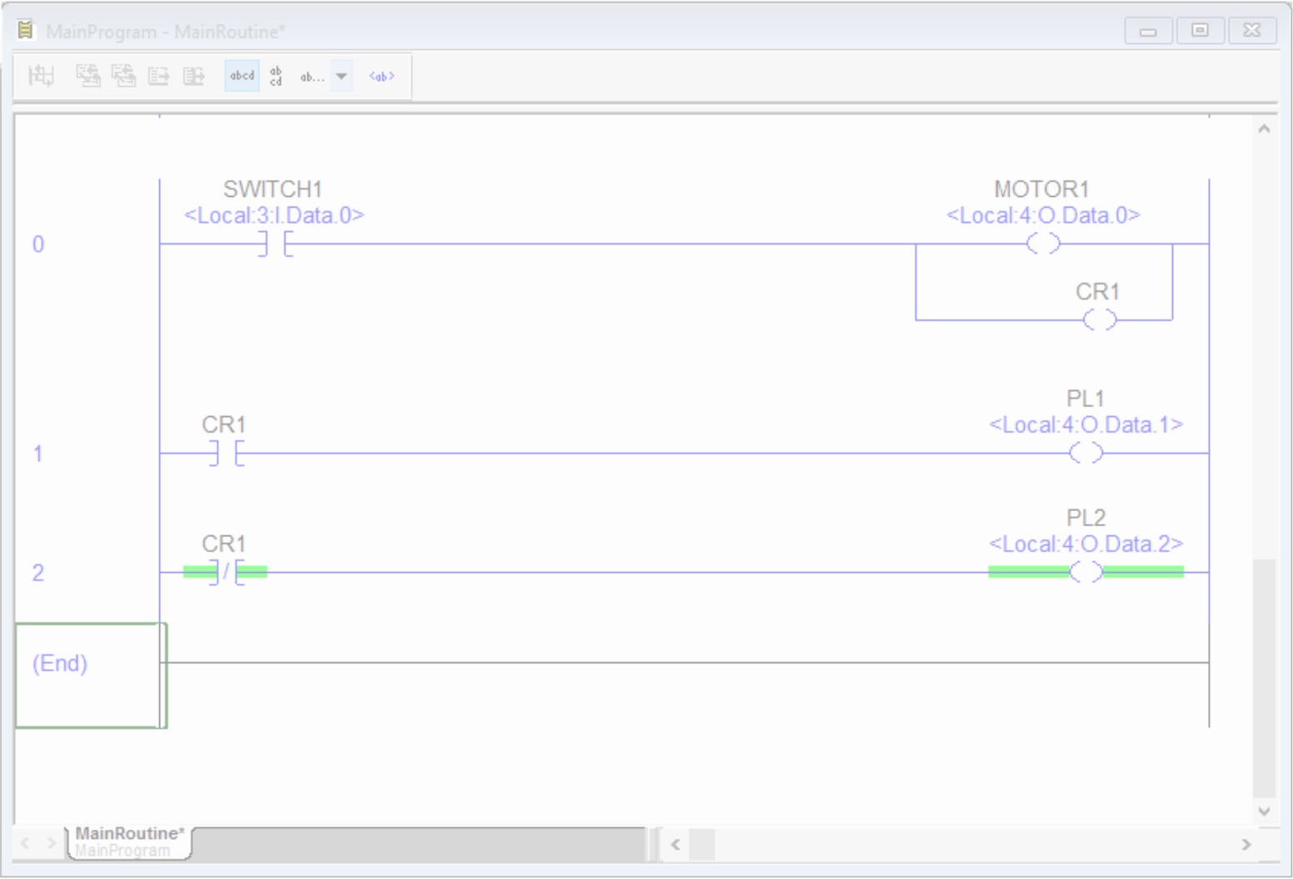
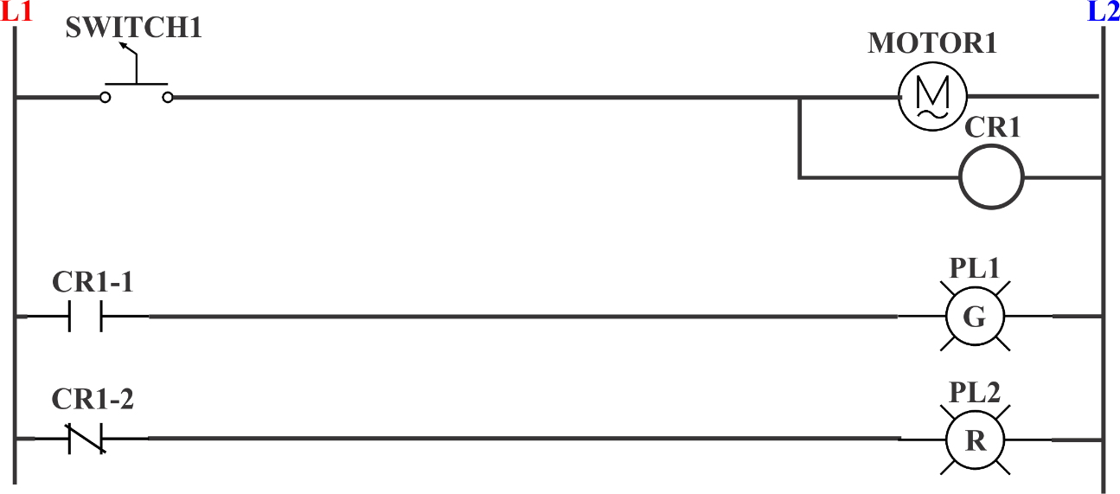
Program Example
Notice in this example, the ladder logic and hardwired are similar.

Slide 25
Program Example
Notice in this example, the ladder logic and hardwired are similar.
NOTE: not all electric circuits and PLC logic circuits are always the same. The differences in the technologies will cause the circuits to be “restructured” to match the technology’s requirements and capabilities.

